Slide 1
Lecture 5: Boolean Data Types and if-statements
Reading: Chapter 3, 3.1 - 3.4

Slide 2
Homework #2 Review

Slide 3
Problem #1
public class TracingProblem
{
public static void main(String[] args)
{
System.out.println("This is the beginning of the program!");
int num1, num2, sum;
num1 = 15;
System.out.println("Number 1 is " + num1);
num2 = 2938;
System.out.println("Number 2 is " + num2);
sum = num1 + num2;
System.out.println("The sum is: ");
System.out.println(sum);
....
Memory
num1:
num2:
sum:
15
2938
2953
Output Window
This is the beginning of the program!
Number 1 is 15
Number 2 is 2938
The sum is:
2938

Slide 4
....
System.out.println("Look at this cool trick");
System.out.println("Inside quotes, then a variable, inside quotes, then a variable.");
String herName = "Melinda";
String hisName = "John";
System.out.println("His name is " + hisName + " and her name is " + herName);
System.out.println("If I'm not careful with spaces around the quotes, look what happens:");
System.out.println("His name is" + hisName + "and her name is" + herName);
System.out.println("Once a variable is declared, it can be used anywhere after that.");
num2 = 22;
sum = num1 + num2;
System.out.println("The sum is " + sum);
}
}
Memory
num1:
num2:
sum:
herName:
hisName:
Output Window (cont.)
Look at this cool trick
Inside quotes, then a variable, inside quotes, then a variable.
His name is John and her name is Melinda
If I’m not careful with spaces around the quotes, look what happens: His name isJohnand her name isMelinda
Once a variable is declared, it can be used anywhere after that.
The sum is 37
15
X
22
2938
X
37
2953
Melinda
John

Slide 5
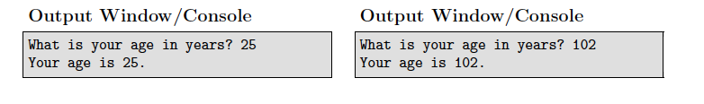
Problem #2
Create a new .java file named WhatsYourAge.java
This program should ask the user for the age (in years).
The program should then print out their age.

Slide 6
import java.util.Scanner;
public class WhatsYourAge
{
public static void main(String[] args)
{
Scanner keyboard = new Scanner(System.in);
int age;
System.out.print("What is your age in years? ");
age = keyboard.nextInt();
System.out.println("Your age is " + age);
}
}
If you’re feeling really confident, you could replace these two lines with:
int age = keyboard.nextInt();

Slide 7
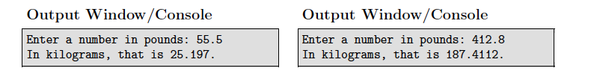
Problem #3
Create a new .java file named PoundsToKilograms.java
Write a program that converts pounds into kilograms.
The program prompts the user to enter a number in pounds.
The program then converts the number to kilograms.
The program then displays the result.

Slide 8
import java.util.Scanner;
public class PoundsToKilograms
{
public static void main(String[] args)
{
Scanner keyboard = new Scanner(System.in);
double pounds;
System.out.print("Enter a number in pounds: ");
pounds = keyboard.nextDouble();
double kilograms = pounds * 0.454;
System.out.println("In kilograms, that is " + kilograms);
}
}

Slide 9
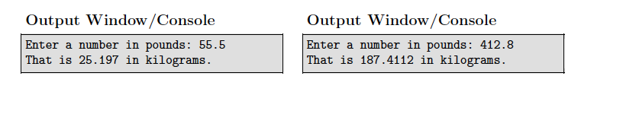
Problem #4
Create a new .java file named PoundsToKilogramsTwo.java
Copy your program from Problem #3 into this new .java file. Make sure you change the class name to be PoundsToKilogramsTwo!
Modify your print statements to look like the new sample output below. You do not have to change the calculations.

Slide 10
import java.util.Scanner;
public class PoundsToKilogramsTwo
{
public static void main(String[] args)
{
Scanner keyboard = new Scanner(System.in);
double pounds;
System.out.print("Enter a number in pounds: ");
pounds = keyboard.nextDouble();
double kilograms = pounds * 0.454;
System.out.println("That is " + kilograms + " in kilograms.");
}
}

Slide 11
The Quiz (Wed. 09/17/14)
Covers Chapters 1 - 2: One tracing problem and one coding problem.
You will lose points if you forget semi-colons or braces or misspell keywords (i.e. public static void main, etc).
You will lose points if you forget to capitalize words that MUST be capitalized (like String) or if you capitalize words that should not be capitalized (like int and double).
Order of operations, remainder operator, increment & decrement, assignment operators, input and output and integer division.
I will provide you with a practice quiz.
Today’s lecture will not be on the quiz (starting Chp. 3).

Slide 12


And yes, you still have homework assigned today!

Slide 13
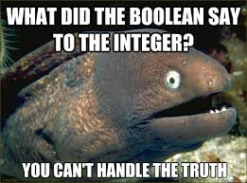
boolean Data Type
First, let’s review our other data types: String, int, double, byte, short, long, float
boolean: Declares that the variables associated with it can only have two values - true or false.
true and false are keywords in Java.
Named boolean after George Boole, an English mathematician, philosopher and logician.
boolean lightsOn = true;

Slide 14
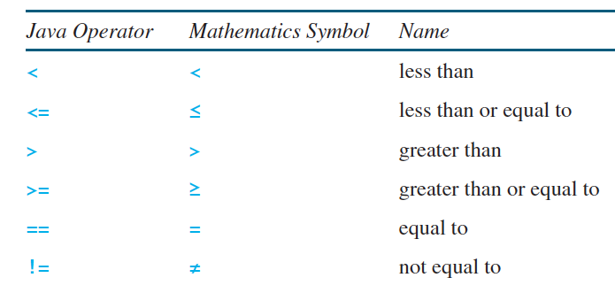
Boolean Expressions
Expressions that, when evaluated, result in having a value of true or false.
These expressions involve the use of relational operators (aka comparison operators).

Slide 15
public class ComparisonOperators
{
public static void main(String[] args)
{
int x, y;
x = 4;
y = 9;
int val = y - x;
System.out.println(val > x);
boolean isBigger = val > x;
System.out.println(isBigger);
val--;
y -= 4;
boolean isEqual = val == x;
System.out.println(isEqual);
isEqual = val == y;
System.out.println(isEqual);
}
}
Memory
x:
y:
val: 5
isBigger: true
isEqual: true
4
✖
9
5
✖
4
✖
false
Output Window
true
true
true
false

Slide 16
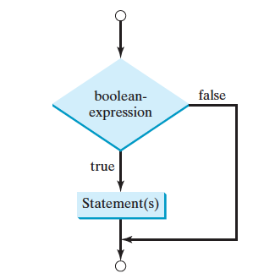
if Statements
An if statement is a piece of code that enables a program to specify alternative paths of execution.
For a program to do anything interesting, it needs if-statements and boolean expressions to control which bits of code to execute
if is a keyword. It MUST be lowercase
The boolean expression must be in parentheses.
if (boolean-expression)
{
// Do really cool stuff inside the if-block
}
Opening and closing braces!
These are the statements that get executed if the boolean expression is true

Slide 17
public class ComparisonOperators
{
public static void main(String[] args)
{
int age = 67;
if (age >= 65)
{
System.out.println(“Time to retire.”);
System.out.println(“Go to Jamaica!); }
if (age < 65)
{
System.out.println(“Keep working.”);
System.out.println(“No vacation for you.”); }
System.out.println(“That’s how if-blocks work!”);
}
}
Memory
age: 67
Look how beautiful the indentation is!
Output Window
Time to retire.
Go to Jamaica!
That’s how if-blocks work!

Slide 18
Example
Write a program that prompts the user to enter an integer. If the number is a multiple of 5 , the program displays “Divisible by 5”. If the number is divisible by 2 , it displays “Divisible by 2”.
Enter an integer: 32
Divisible by 2
Enter an integer: 35
Divisible by 5
Enter an integer: 30
Divisible by 5
Divisible by 2
How do we know if something is divisible by 2 or 5?
If the remainder is 0.
i.e. number % 5 == 0, number % 2 == 0

Slide 19
import java.util.Scanner;
public class Divisible
{
public static void main(String[] args)
{
Scanner keyboard = new Scanner(System.in);
int num;
System.out.print(“Enter an integer: ”);
num = keyboard.nextInt();
if (num % 5 == 0)
{
System.out.println(“Divisible by 5”);
}
if (num % 2 == 0)
{
System.out.println(“Divisible by 2”);
}
}
}

Slide 20
import java.util.Scanner;
public class Divisible
{
public static void main(String[] args)
{
Scanner keyboard = new Scanner(System.in);
int num;
System.out.print(“Enter an integer: ”);
num = keyboard.nextInt();
boolean byFive = num % 5 == 0;
boolean byTwo = num % 2 == 0;
if (byFive)
{
System.out.println(“Divisible by 5”);
}
if (byTwo)
{
System.out.println(“Divisible by 2”);
}
}
}

Slide 21
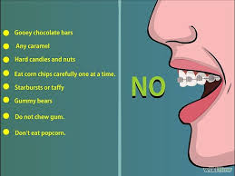
So sick of braces...
IF you only have one line inside your if-block, then you don’t have to use braces.
if (num % 5 == 0)
{
System.out.println(“Divisible by 5”);
}
if (num % 5 == 0)
System.out.println(“Divisible by 5”);

Slide 22
What if I forget them with multiple statements?
int age = 64;
if (age >= 65)
{
System.out.println(“Time to retire.”);
System.out.println(“Go to Jamaica!); }
System.out.println(“Done with the if-block”);
int age = 64;
if (age >= 65)
System.out.println(“Time to retire.”);
System.out.println(“Go to Jamaica!);
System.out.println(“Done with the if-block”);
Output Window
Done with the if-block
Output Window
Go to Jamaica!
Done with the if-block!
Java only associates the line immediately following the if with the if-block. It thinks anything else is outside the if-block!!

Slide 23
import java.util.Scanner;
public class Divisible
{
public static void main(String[] args)
{
Scanner keyboard = new Scanner(System.in);
int num;
System.out.print(“Enter an integer: ”);
num = keyboard.nextInt();
if (num % 5 == 0)
System.out.println(“Divisible by 5”);
if (num % 2 == 0)
System.out.println(“Divisible by 2”);
}
}

Slide 24
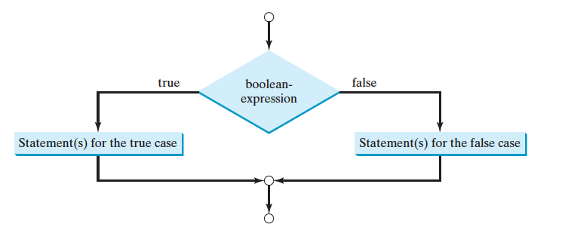
Two-way if-else statements
A one-way if statement performs an action if the specified condition is true.
If the condition is false, nothing is done.
But what if you want to take alternative actions when the condition is false ?
You use a two-way if-else statement.

Slide 25
Two-way if-else syntax
if is a keyword. It MUST be lowercase
The boolean expression must be in parentheses.
if (boolean-expression)
{
// Do really cool stuff if its true
}
else
{
// Do different cool stuff if its false
}
else is a keyword. It MUST be lowercase
Two sets of opening and closing braces!

Slide 26
public class ComparisonOperators
{
public static void main(String[] args)
{
int age = 67;
if (age >= 65)
{
System.out.println(“Time to retire.”);
System.out.println(“Go to Jamaica!); }
if (age < 65)
{
System.out.println(“Keep working.”);
System.out.println(“No vacation for you.”); }
System.out.println(“That’s how if-blocks work!”);
}
}
public class ComparisonOperators
{
public static void main(String[] args)
{
int age = 67;
if (age >= 65)
{
System.out.println(“Time to retire.”);
System.out.println(“Go to Jamaica!); }
else
{
System.out.println(“Keep working.”);
System.out.println(“No vacation for you.”); }
System.out.println(“That’s how if-blocks work!”);
}
}
Because either age is greater than or equal to 65....or it is less than 65.

Slide 27
Braces again...
IF you only have one line inside your if-block or your else-block, then you don’t have to use braces.
int age = 67;
if (age >= 65)
{
System.out.println(“Time to retire.”);
}
else
{
System.out.println(“Keep working.”);
}
int age = 67;
if (age >= 65)
System.out.println(“Time to retire.”);
else
System.out.println(“Keep working.”);

Slide 28
What if you forget the braces when you have multiple lines in a two-way if-else statement?
If you forget them in the if-block:
If you forget them in the else-block:
int age = 67;
if (age >= 65)
System.out.println(“Time to retire.”);
System.out.println(“Go to Jamaica!”);
else
System.out.println(“Keep working.”);
int age = 64;
if (age >= 65)
System.out.println(“Time to retire.”);
else
System.out.println(“Keep working.”);
System.out.println(“No vacation for you.”);
Syntax Error!!
Wrong output!

Slide 29
Example
Write a program that prompts the user to enter an integer. If the number is even, the
program displays “Even Number”. If the number is odd, it displays “Odd Number”.
Enter an integer: 32
Even Number
Enter an integer: 35
Odd Number
How do we know if something is even?
If the remainder is 0 when we divide by 2.
i.e. number % 2 == 0 If it’s not even, then it MUST be odd.

Slide 30
import java.util.Scanner;
public class EvenOrOdd
{
public static void main(String[] args)
{
Scanner keyboard = new Scanner(System.in);
int num;
System.out.print(“Enter an integer: ”);
num = keyboard.nextInt();
if (num % 2 == 0)
System.out.println(“Even Number”);
else
System.out.println(“Odd Number”);
}
}

Slide 31
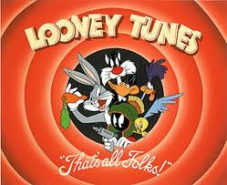
That’s all for today folks!
Read Chapter 3, Sections 3.1 - 3.4 Your homework will be posted online and is due Wednesday, 09/17/14 by the beginning of class.

